Slide 1
Funnels with conversion rates
Three, four, five and six levels
Three levels
Four levels
Five levels
Six levels
Level 1
P PPP PPP
Level 1
XXX XXX
Level 1
P PPP PPP
Level 1
P PPP PPP
XX%
XX%
XX%
Level 2
XXX XXX
XX%
Level 2
XXX XXX
Level 2
YY YYY
XX%
XX%
Level 3
YY YYY
Level 2
YY YYY
XX%
Level 3
YY YYY
XX%
XX%
Level 4
Z ZZZ
Level 3
Z ZZZ
Level 4
Z ZZZ
XX%
XX%
Level 5
WWW
XX%
XX%
XX%
Level 3
WWW
Level 4
WWW
Level 5
WWW
Level 6
SSS

Slide 2
Three level funnels with conversion
Five brands
Brand name here
Brand name here
Brand name here
Brand name here
Brand name here
XX | XX | XX | XX | XX
XX | XX | XX | XX | XX
XX | XX | XX | XX | XX
Level 1
XX%
XX%
XX%
XX%
XX%
Level 2
XX%
XX%
XX%
XX%
XX%
Level 3

Slide 3
Three level funnels with conversion
Eleven brands
Brand name here
Brand name here
Brand name here
Brand name here
Brand name here
Brand name here
Brand name here
Brand name here
Brand name here
Brand name here
Brand name here
XX | XX | XX | XX | XX | XX | XX | XX | XX | XX | XX
XX | XX | XX | XX | XX | XX | XX | XX | XX | XX | XX
XX | XX | XX | XX | XX | XX | XX | XX | XX | XX | XX
Level 1
XX%
XX%
XX%
XX%
XX%
XX%
XX%
XX%
XX%
XX%
XX%
Level 2
XX%
XX%
XX%
XX%
XX%
XX%
XX%
XX%
XX%
XX%
XX%
Level 3

Slide 4
Four level funnels with conversion
Five brands
Brand name here
Brand name here
Brand name here
Brand name here
Brand name here
Level 1
XX | XX | XX | XX | XX
XX | XX | XX | XX | XX
XX | XX | XX | XX | XX
XX | XX | XX | XX | XX
XX%
XX%
XX%
XX%
XX%
Level 2
XX%
XX%
XX%
XX%
XX%
Level 3
XX%
XX%
XX%
XX%
XX%
Level 4

Slide 5
Four level funnels with conversion
Eleven brands
Brand name here
Brand name here
Brand name here
Brand name here
Brand name here
Brand name here
Brand name here
Brand name here
Brand name here
Brand name here
Brand name here
XX | XX | XX | XX | XX | XX | XX | XX | XX | XX | XX
XX | XX | XX | XX | XX | XX | XX | XX | XX | XX | XX
XX | XX | XX | XX | XX | XX | XX | XX | XX | XX | XX
XX | XX | XX | XX | XX | XX | XX | XX | XX | XX | XX
Level 1
XX%
XX%
XX%
XX%
XX%
XX%
XX%
XX%
XX%
XX%
XX%
Level 2
XX%
XX%
XX%
XX%
XX%
XX%
XX%
XX%
XX%
XX%
XX%
Level 3
XX%
XX%
XX%
XX%
XX%
XX%
XX%
XX%
XX%
XX%
XX%
Level 4

Slide 6
Five level funnels with conversion
Five brands
Brand name here
Brand name here
Brand name here
Brand name here
Brand name here
Level 1
XX | XX | XX | XX | XX
XX | XX | XX | XX | XX
XX | XX | XX | XX | XX
XX | XX | XX | XX | XX
XX | XX | XX | XX | XX
XX%
XX%
XX%
XX%
XX%
Level 2
XX%
XX%
XX%
XX%
XX%
Level 3
XX%
XX%
XX%
XX%
XX%
Level 4
XX%
XX%
XX%
XX%
XX%
Level 5

Slide 7
Five level funnels with conversion
Eleven brands
Brand name here
Brand name here
Brand name here
Brand name here
Brand name here
Brand name here
Brand name here
Brand name here
Brand name here
Brand name here
Brand name here
XX | XX | XX | XX | XX | XX | XX | XX | XX | XX | XX
XX | XX | XX | XX | XX | XX | XX | XX | XX | XX | XX
XX | XX | XX | XX | XX | XX | XX | XX | XX | XX | XX
XX | XX | XX | XX | XX | XX | XX | XX | XX | XX | XX
XX | XX | XX | XX | XX | XX | XX | XX | XX | XX | XX
Level 1
XX%
XX%
XX%
XX%
XX%
XX%
XX%
XX%
XX%
XX%
XX%
Level 2
XX%
XX%
XX%
XX%
XX%
XX%
XX%
XX%
XX%
XX%
XX%
Level 3
XX%
XX%
XX%
XX%
XX%
XX%
XX%
XX%
XX%
XX%
XX%
Level 4
XX%
XX%
XX%
XX%
XX%
XX%
XX%
XX%
XX%
XX%
XX%
Level 5

Slide 8
Six level funnels with conversion
Five brands
Brand name here
Brand name here
Brand name here
Brand name here
Brand name here
Level 1
XX | XX | XX | XX | XX
XX | XX | XX | XX | XX
XX | XX | XX | XX | XX
XX | XX | XX | XX | XX
XX | XX | XX | XX | XX
XX | XX | XX | XX | XX
XX%
XX%
XX%
XX%
XX%
Level 2
XX%
XX%
XX%
XX%
XX%
Level 3
XX%
XX%
XX%
XX%
XX%
Level 4
XX%
XX%
XX%
XX%
XX%
Level 5
XX%
XX%
XX%
XX%
XX%
Level 6

Slide 9
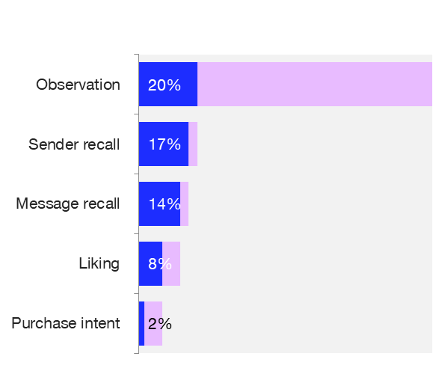
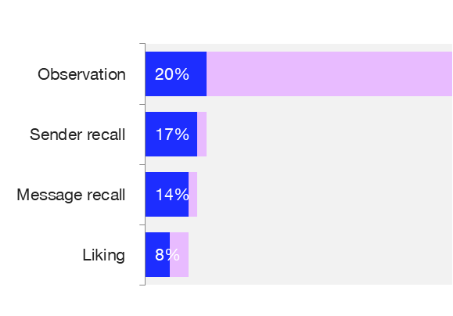
Chart funnel with loss rates and conversion rates
Four and five steps: Loss rates in grey
85% (60%)
85% (60%)
82% (40%)
82% (40%)
57% (40%)
57% (40%)
25% (33%)

Slide 10

Scatter plot
Paste your scatter plot in the graph template below
Comments
While that's mock-ups and this is politics, are they really so different? My text is long and beautiful, as, it has been well documented, are various other parts of my website. That other text? Sadly, it’s no longer a 10.
Dimension Y
Dimension X

Slide 11
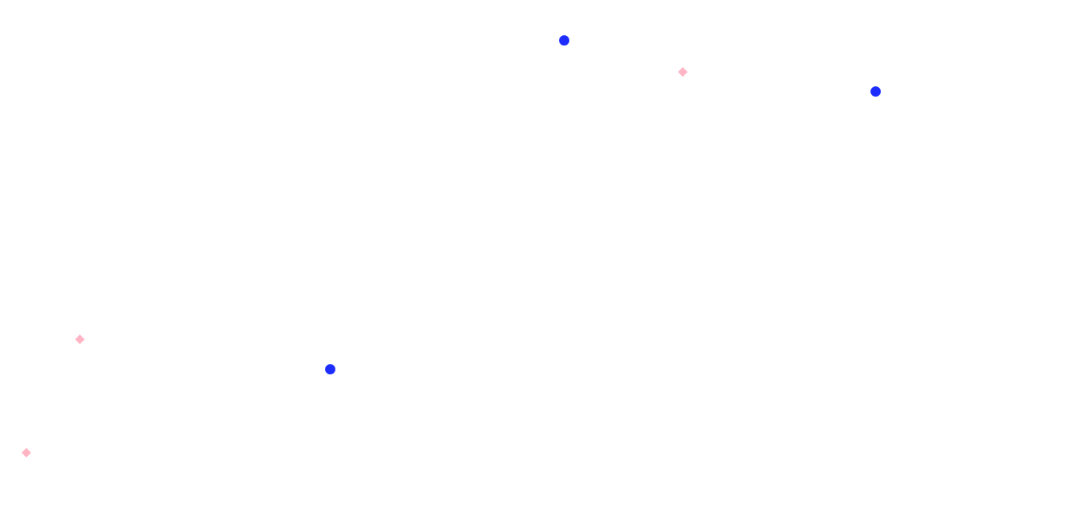
MDS
Paste your MDS in the dark area
Comments
While that's mock-ups and this is politics, are they really so different? My text is long and beautiful, as, it has been well documented, are various other parts of my website. That other text? Sadly, it’s no longer a 10.

Slide 12
Funnels and pyramids
Three and four levels
Consideration
Preference
Purchase
Consideration
Brand Awareness
Ad awareness
Ad awareness
Brand Awareness
Consideration
Preference
Preference
Consideration
Brand Awareness
Ad awareness

Slide 13
Funnels and pyramids
Five and six levels
Ad awareness
Brand Awareness
Consideration
Preference
Purchase
Purchase
Preference
Consideration
Brand Awareness
Ad awareness
Ad awareness
Brand Awareness
Consideration
Preference
Purchase
Loyalty
Loyalty
Purchase
Preference
Consideration
Brand Awareness
Ad awareness

Slide 14
Venn diagram
Two and three
Tech
Research
Tech
Research
Tech
Research
Tech
Research
Consulting
Consulting
Consulting
Consulting
Tech
Research
Tech
Research
Tech
Research
Tech
Research

